Slide 1
A multilevel iterated-shrinkage approach to l1 penalized least-squares
Eran Treister and Irad Yavneh
Computer Science, Technion

Slide 2
Sparse representation of signals
A
x
≈
f
Signal
Sparse Representation
Dictionary
(matrix)
The signal f – represented by only a few columns of A.
The matrix A is redundant (# columns > # rows).

Slide 3
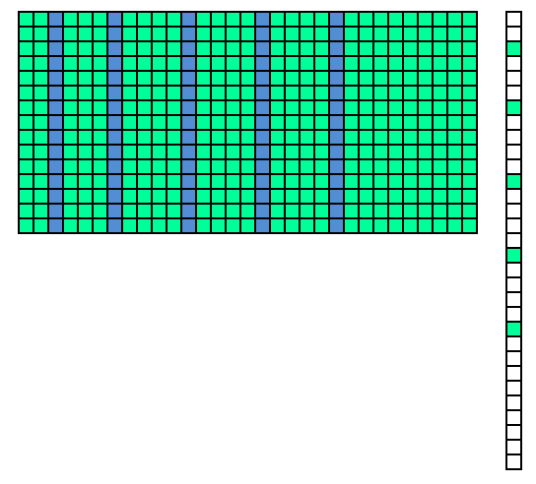
Sparse representation
The support – the set of columns that comprise the signal.
S = supp{x} = {i : x_{i} ≠ 0}.
A
x
≈
f
x_{S} – Support
sub-vector
A_{S} -
Support sub-matrix

Slide 4
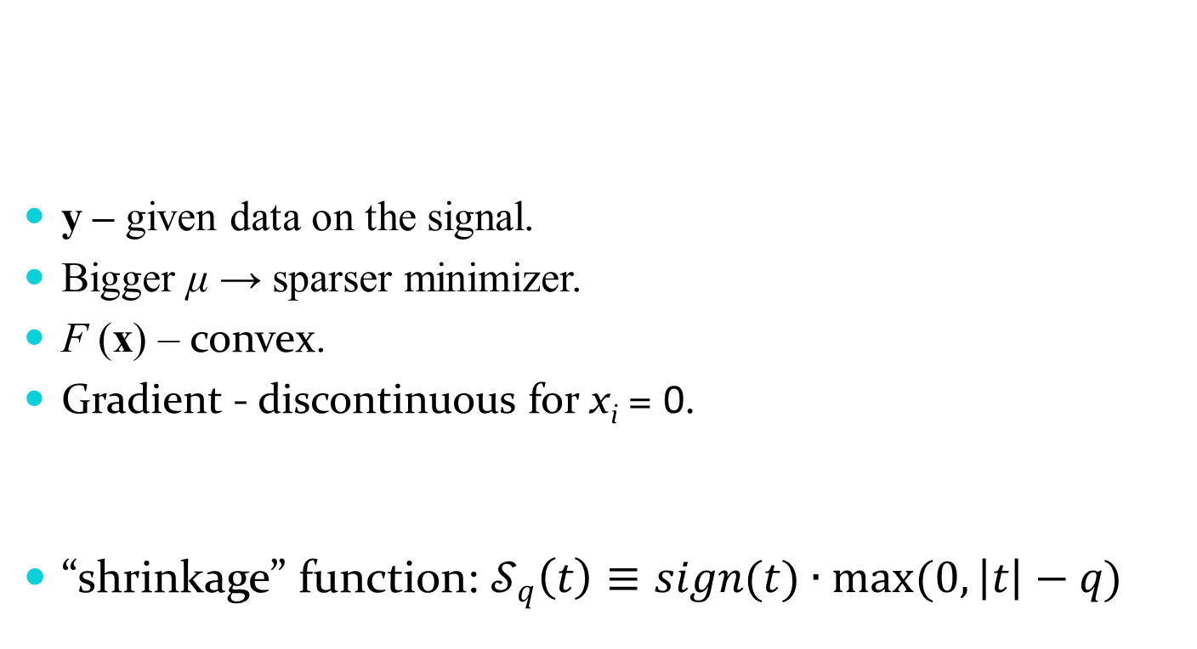
l₁ penalized least-squares
y – given data on the signal.
Bigger μ → sparser minimizer.
F (x) – convex.
Gradient - discontinuous for x_{i} = 0.
“shrinkage” function: $𝒮_{q}\left(t\right)≡sign(t)∙max⁡(0,\left|t\right|−q)$

Slide 5

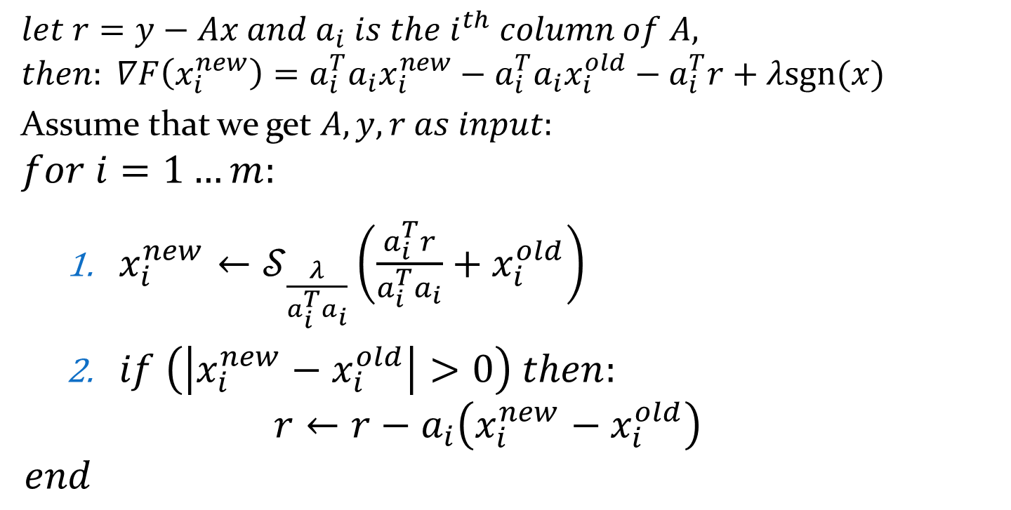
Coordinate Descent
$$let r=y−Ax and a_{i} is the i^{th} column of A,$$
$$then: ∇F\left(x_{i}^{new}\right)=a_{i}^{T}a_{i}x_{i}^{new}−a_{i}^{T}a_{i}x_{i}^{old}−a_{i}^{T}r+λsgn(x)$$
Assume that we get $A, y, r as input:$
$$for i=1…m:$$
$x_{i}^{new}←𝒮_{\frac{λ}{a_{i}^{T}a_{i}}}\left(\frac{a_{i}^{T}r}{a_{i}^{T}a_{i}}+x_{i}^{old}\right)$
$if \left(\left|x_{i}^{new}−x_{i}^{old}\right|>0\right) then:$
$$r←r−a_{i}\left(x_{i}^{new}−x_{i}^{old}\right)$$
$$end$$
Comlexity:
$O(n)$
$O\left(n\right)$
$$→O\left(nm\right)+O\left(kn\right)$$
$$=O\left(nm\right)$$

Slide 6
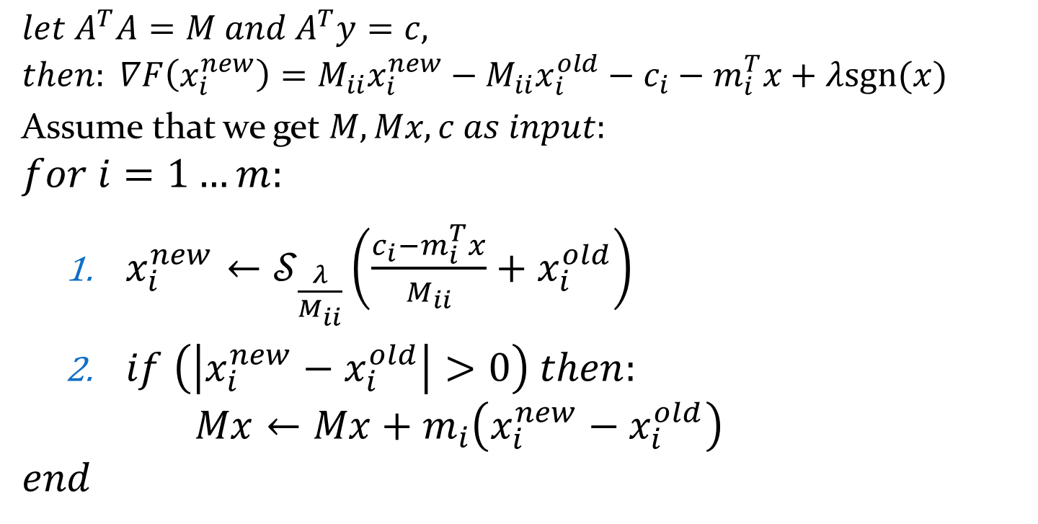

Coordinate Descent
$$let A^{T}A=M and A^{T}y=c,$$
$$then: ∇F\left(x_{i}^{new}\right)=M_{ii}x_{i}^{new}−M_{ii}x_{i}^{old}−c_{i}−m_{i}^{T}x+λsgn(x)$$
Assume that we get $M, Mx, c as input:$
$$for i=1…m:$$
$x_{i}^{new}←𝒮_{\frac{λ}{M_{ii}}}\left(\frac{c_{i}−m_{i}^{T}x}{M_{ii}}+x_{i}^{old}\right)$
$if \left(\left|x_{i}^{new}−x_{i}^{old}\right|>0\right) then:$
$$Mx←Mx+m_{i}\left(x_{i}^{new}−x_{i}^{old}\right)$$
$$end$$
Complexity:
$O\left(1\right)$
$O\left(m\right)$
$$→O\left(m\right)+k∗O\left(m\right)$$
$$=O(km)$$

Slide 7
Multilevel Iterated Shrinkage

Slide 8
The main idea
The solution is sparse – most columns will not end up in the support!
At each stage:
Many columns are highly unlikely to contribute to the minimizer.
Such columns can be “temporarily” dropped – resulting in a smaller problem.

Slide 9
The main idea
An iterative multilevel process:
Defines a hierarchy of nested (low-level) sub-dictionaries.
Applies existing iterated shrinkage methods at each level using its sub-dictionary.

Slide 10
Restricting the problem
Fine level problem:
Choose a subset of variables C s.t
We define a “low-level” sub-problem:

Slide 11
Restricting the problem
Fine level problem:
Choose a subset of variables C s.t
Resulting in a “low-level” sub-problem:
equal
A_{c}- sub-dictionary

Slide 12
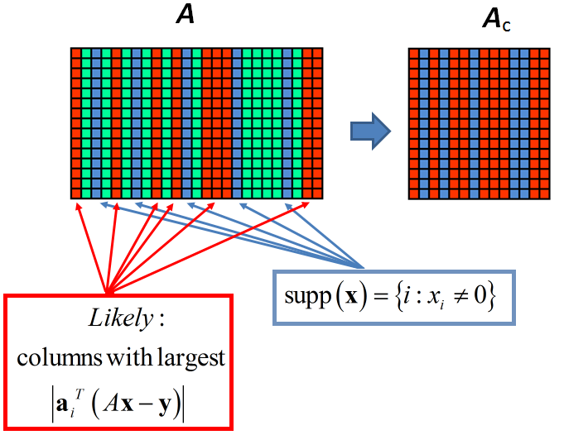
Low-level Dictionary choosing m_{c} = m/2 columns

Slide 13
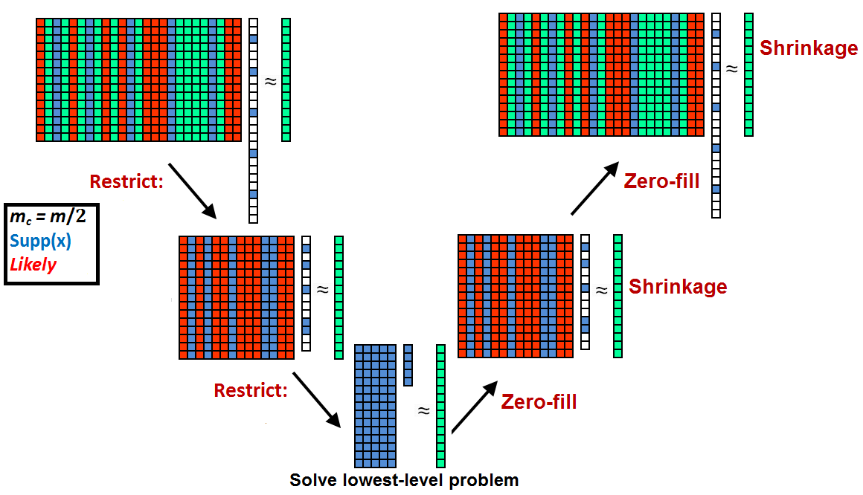
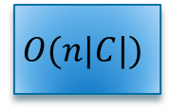
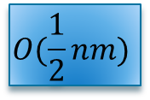
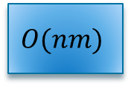
The multilevel V cycle Repeated iteratively until convergence
$$O(nm)$$
$$O(\frac{1}{2}nm)$$
$$O(n|C|)$$

Slide 14

V cycle rum-time complexity
By solving the problem with $A, y, r$ parameters:
$$nm+\frac{1}{2}nm+\frac{1}{4}nm+…+n\left|C\right|=nm\left(1+\frac{1}{2}+\frac{1}{4}+…\right)+n\left|C\right|≤2nm+n|C|$$

Slide 15
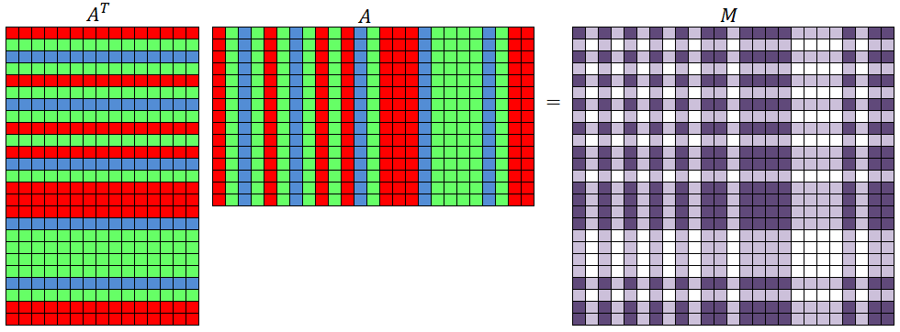
Low-level Dictionary

Slide 16
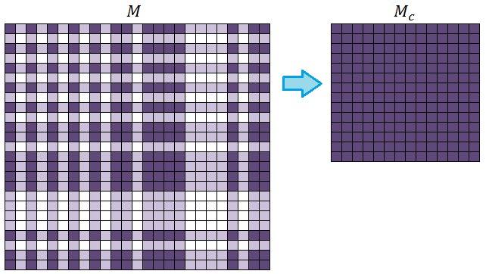
Low-level Dictionary choosing m_{c} = m/2 columns

Slide 17
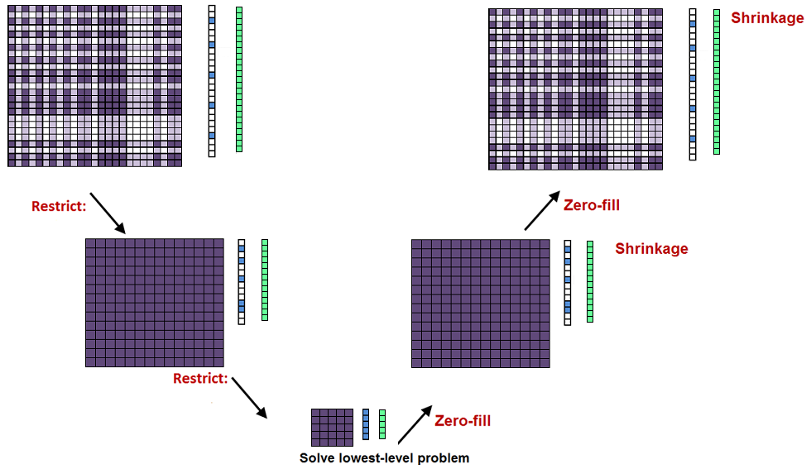
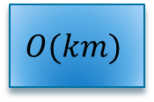
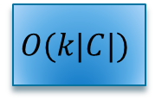
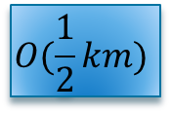
The multilevel V cycle Repeated iteratively until convergence
$$O(km)$$
$$O(\frac{1}{2}km)$$
$$O(k|C|)$$

Slide 18
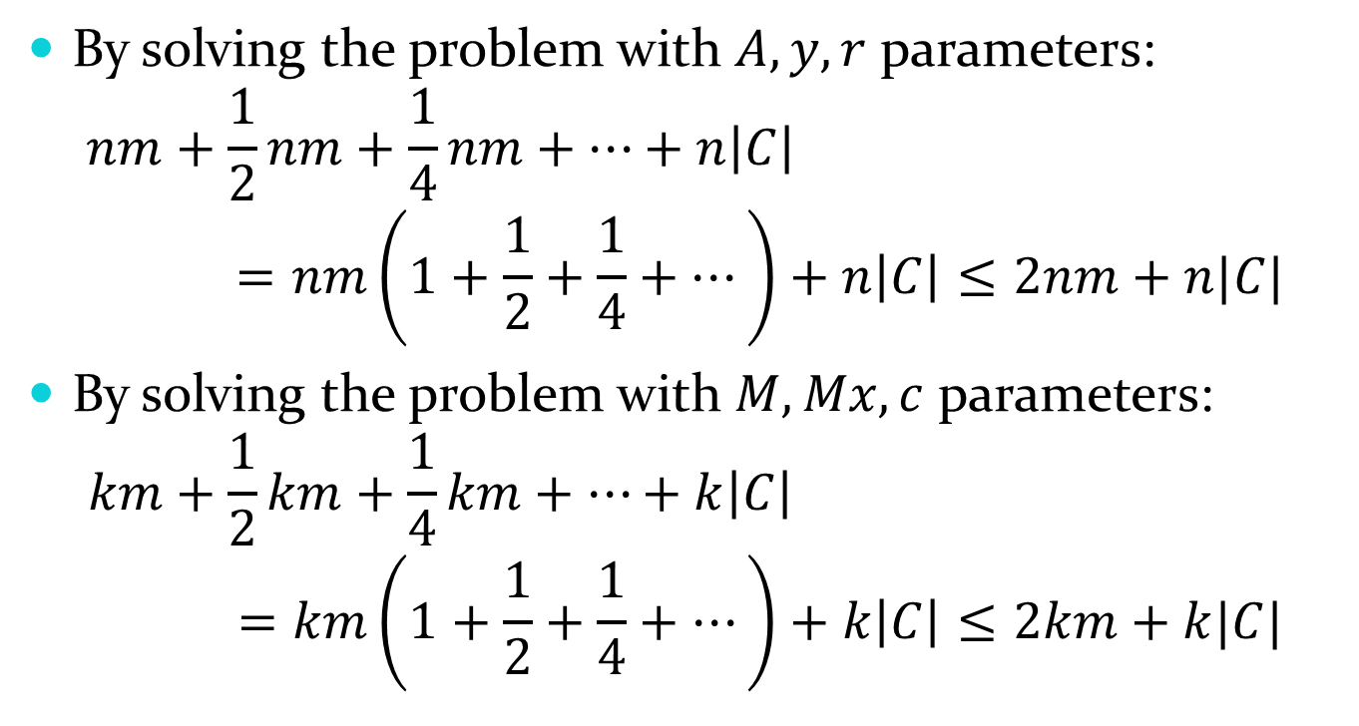
V cycle rum-time complexity
By solving the problem with $A, y, r$ parameters:
$$nm+\frac{1}{2}nm+\frac{1}{4}nm+…+n\left|C\right|=nm\left(1+\frac{1}{2}+\frac{1}{4}+…\right)+n\left|C\right|≤2nm+n|C|$$
By solving the problem with $M, Mx, c$ parameters:
$$km+\frac{1}{2}km+\frac{1}{4}km+…+k\left|C\right|=km\left(1+\frac{1}{2}+\frac{1}{4}+…\right)+k\left|C\right|≤2km+k|C|$$

Slide 19
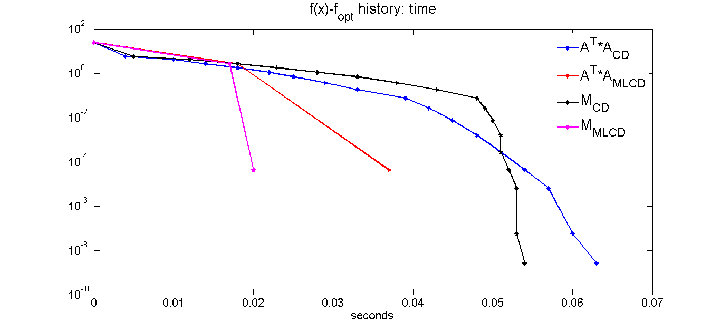

Numerical Results
$$A∈ℝ^{512×2048}, λ=0.08$$
Notes:
Rand plain

Slide 20
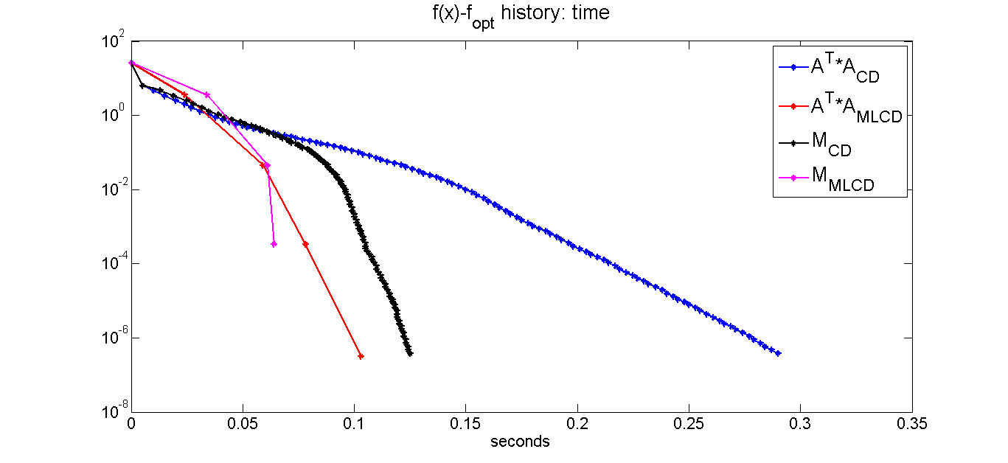
Numerical Results
$$A∈ℝ^{512×2048}, λ=0.08$$
Notes:
Rand sign

Slide 21
A Multilevel Approach for Sparse Inverse Covariance Estimation
Eran Treister, Aviva Herman, Irad Yavneh
Department of computer science, Technion, Israel

Slide 22
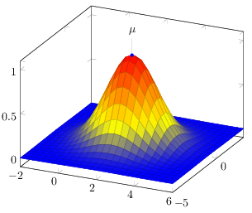
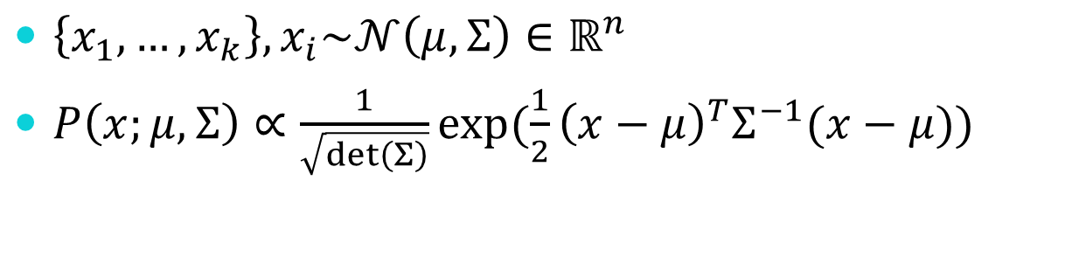
Multivariate normal distribution
$\left\{x_{1},…,x_{k}\right\}, x_{i}\sim 𝒩\left(μ,Σ\right)∈ℝ^{n}$
$P\left(x;μ,Σ\right)∝\frac{1}{\sqrt{\det\left(Σ\right)}}exp⁡(\frac{1}{2}{\left(x−μ\right)}^{T}Σ^{−1}(x−μ))$

Slide 23

Applications

Slide 24

Standard estimation of parameters
$\hat{μ}=\frac{1}{m}\sum_{i=1}^{m}{x_{i}}$
$\hat{Σ}=S=\frac{1}{m−1}\sum_{i=1}^{m}{\left(x_{i}−\hat{μ}\right){\left(x_{i}−\hat{μ}\right)}^{T}}∈ℝ^{n×n}$
The Problem:
If $m<n$, $S$ is not full-rank ($Σ$ is full-rank)

Slide 25
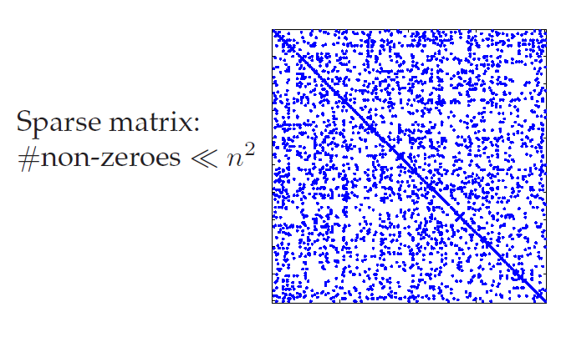

Standard estimation of parameters
Our aim:
Estimate $Σ^{−1}$, assuming that it is sparse
Notes:
ניתן להניח דלילות:
כדי למצוא אילו נקודות אכן תלויות וקשורות זו בזו
לצורך הפתרון ויצירת הרמות בהמשך

Slide 26
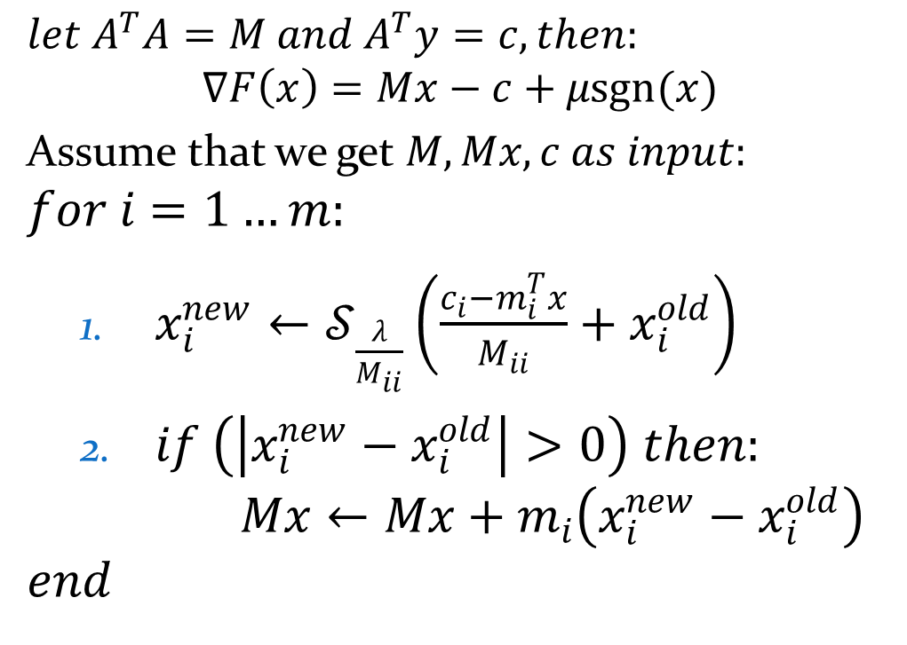
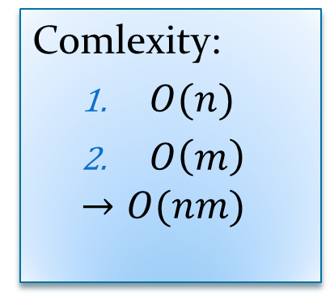
Convex optimization with $l_{1}$ regularization
$$\min_{A≻0∈ℝ^{n×n}}{F(A)}=\min_{A≻0∈ℝ^{n×n}}{−\log{\det\left(A\right)}+tr\left(AS\right)+λ{\left\|A\right\|}_{1}}$$
$λ>0$: sparsity regularization parameter
$$∇F\left(A\right)=S−A^{−1}$$

Slide 27
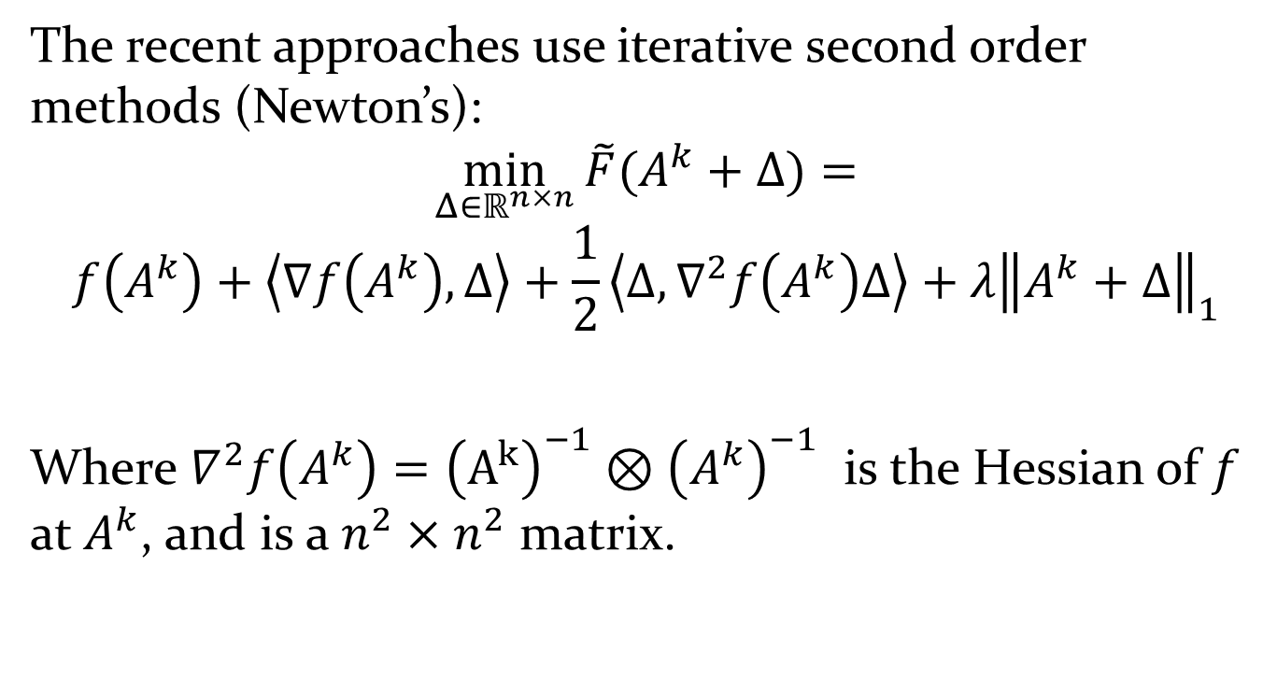
Iterated shrinkage “relaxations”
The recent approaches use iterative second order methods (Newton’s):
$$\min_{Δ∈ℝ^{n×n}}{\tilde{F}(A^{k}+Δ)}=$$
$$f\left(A^{k}\right)+\left\langle ∇f\left(A^{k}\right),Δ\right\rangle +\frac{1}{2}\left\langle Δ,∇^{2}f\left(A^{k}\right)Δ\right\rangle +λ{\left\|A^{k}+Δ\right\|}_{1}$$
Where $∇^{2}f\left(A^{k}\right)={\left(A^{k}\right)}^{−1}⊗{\left(A^{k}\right)}^{−1}$ is the Hessian of $f$ at $A^{k}$, and is a $n^{2}×n^{2}$ matrix.

Slide 28
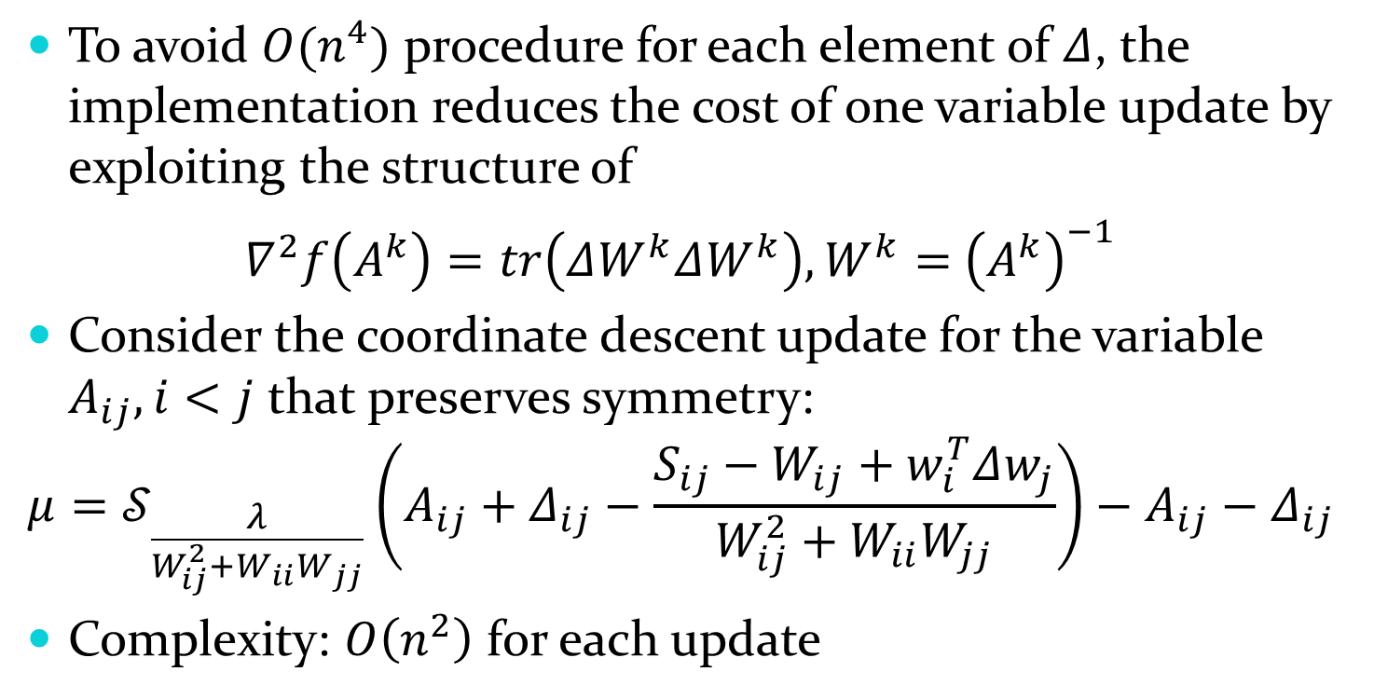
Coordinate Descent
To avoid $O(n^{4})$ procedure for each element of $Δ$, the implementation reduces the cost of one variable update by exploiting the structure of
$∇^{2}f\left(A^{k}\right)=tr\left(ΔW^{k}ΔW^{k}\right), W^{k}=$ ${\left(A^{k}\right)}^{−1}$
Consider the coordinate descent update for the variable $A_{ij}, i<j$ that preserves symmetry:
$$μ=𝒮_{\frac{λ}{W_{ij}^{2}+W_{ii}W_{jj}}}\left(A_{ij}+Δ_{ij}−\frac{S_{ij}−W_{ij}+w_{i}^{T}Δw_{j}}{W_{ij}^{2}+W_{ii}W_{jj}}\right)−A_{ij}−Δ_{ij}$$
Complexity: $O\left(n^{2}\right)$ for each update

Slide 29
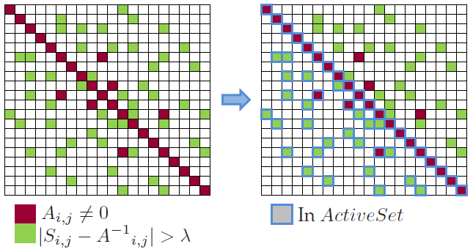
Iterated shrinkage “relaxations”
Each relaxation restricted to an
$$ActiveSet=\{\left(i,j\right), i≤j;A_{i,j}≠0∨\left|S_{i,j}−A_{i,j}^{−1}\right|>λ\}$$

Slide 30
Multilevel Iterated Shrinkage

Slide 31
The main idea (again)
The solution is sparse – most entries will not end up in the support!
At each stage:
Many entries are highly unlikely to contribute to the minimizer.
Such entries can be “temporarily” dropped – resulting in a smaller problem.

Slide 32
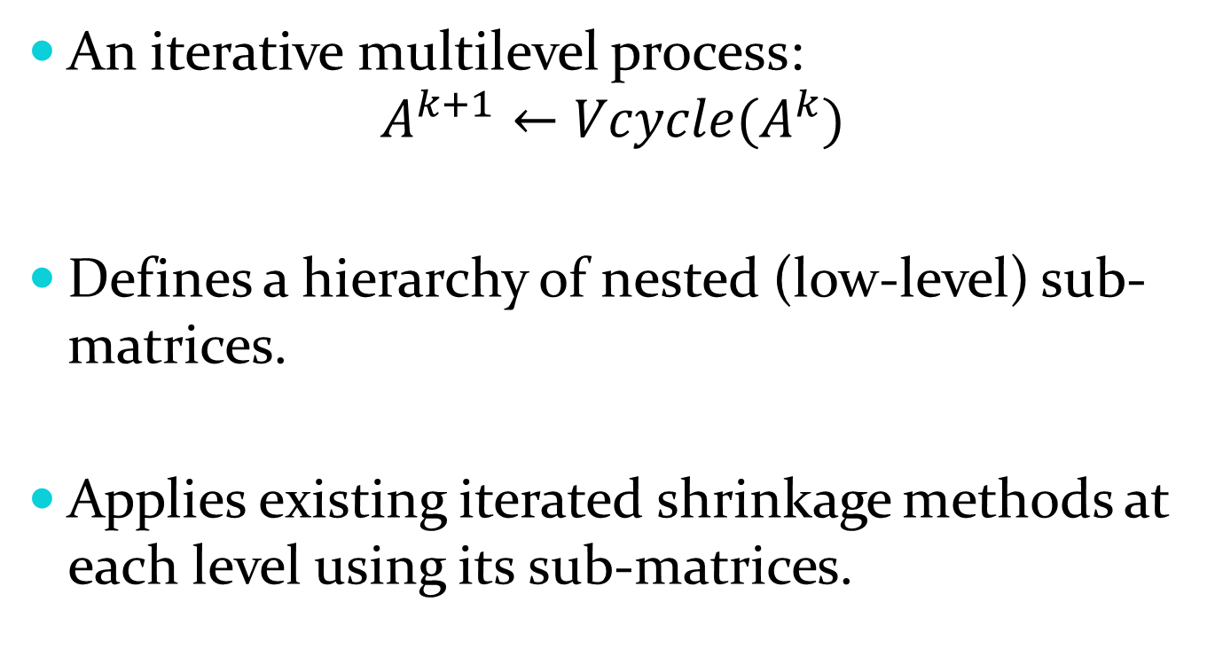
The main idea
An iterative multilevel process:
$$A^{k+1}←Vcycle(A^{k})$$
Defines a hierarchy of nested (low-level) sub-matrices.
Applies existing iterated shrinkage methods at each level using its sub-matrices.

Slide 33
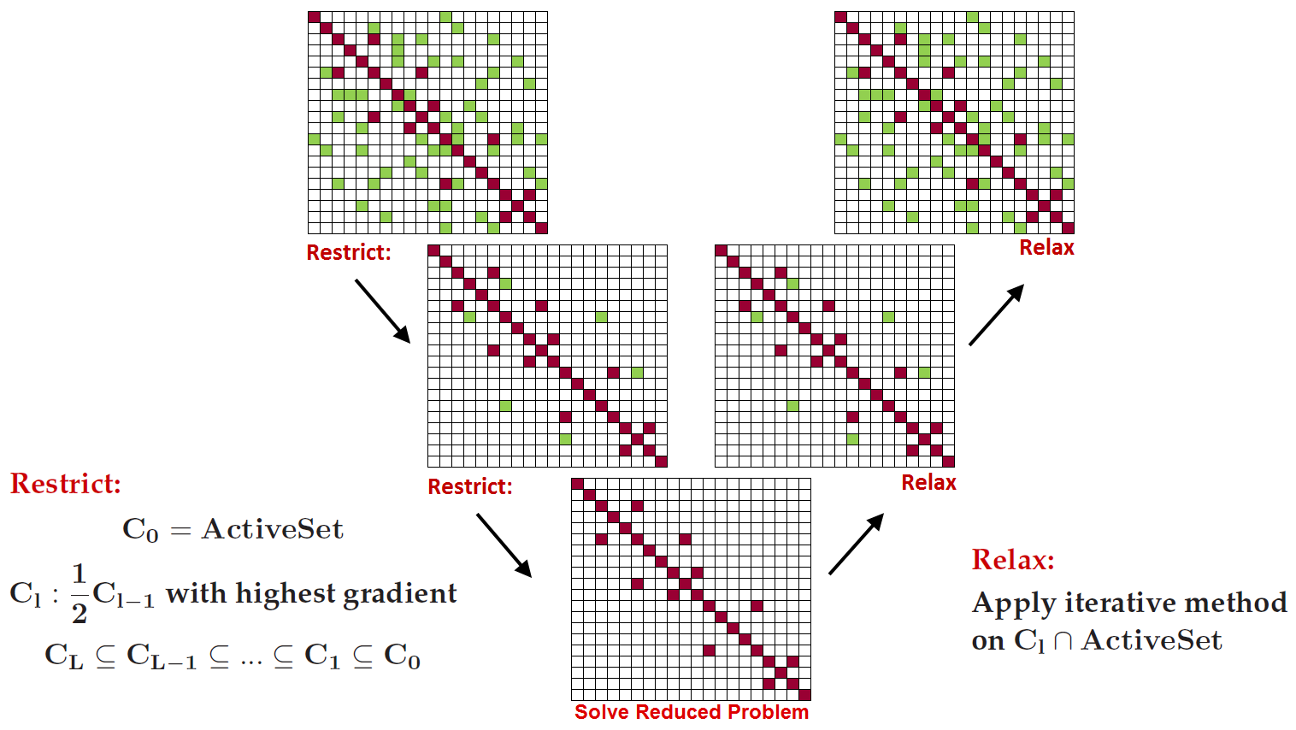
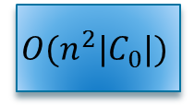


The multilevel V cycle Repeated iteratively until convergence
$$O(n^{2}|C_{0}|)$$
$$O(\frac{1}{2}n^{2}|C_{0}|)$$
$$O(n^{2}|C_{L}|)$$

Slide 34

V cycle rum-time complexity
$$n^{2}|C_{0}|+\frac{1}{2}n^{2}|C_{0}|+\frac{1}{4}n^{2}|C_{0}|+…+n^{2}\left|C_{L}\right|=n^{2}|C_{0}|\left(1+\frac{1}{2}+\frac{1}{4}+…\right)+n\left|C_{L}\right|≤2n^{2}|C_{0}|+n^{2}|C_{L}|$$

Slide 35
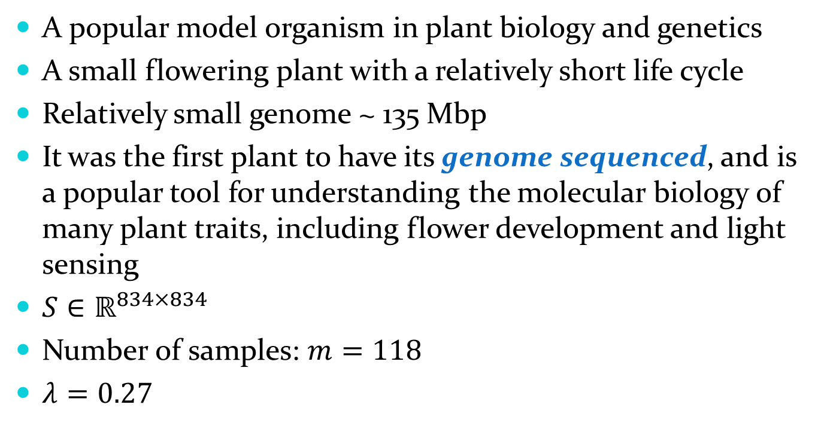
Numerical Results: Arabidopsis
A popular model organism in plant biology and genetics
A small flowering plant with a relatively short life cycle
Relatively small genome ~ 135 Mbp
It was the first plant to have its genome sequenced, and is a popular tool for understanding the molecular biology of many plant traits, including flower development and light sensing
$S∈ℝ^{834×834}$
Number of samples: $m=118$
$λ=0.27$

Slide 36
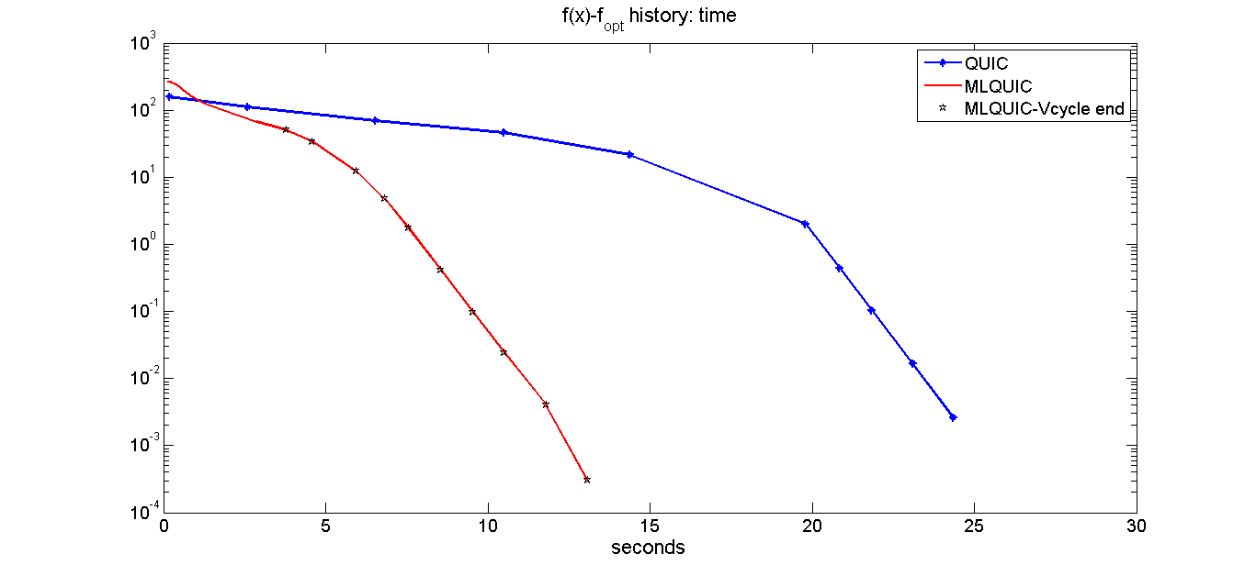

Numerical Results: Arabidopsis
Convergence history: $\left|F\left(A\right)−F_{min}\right|$

Slide 37
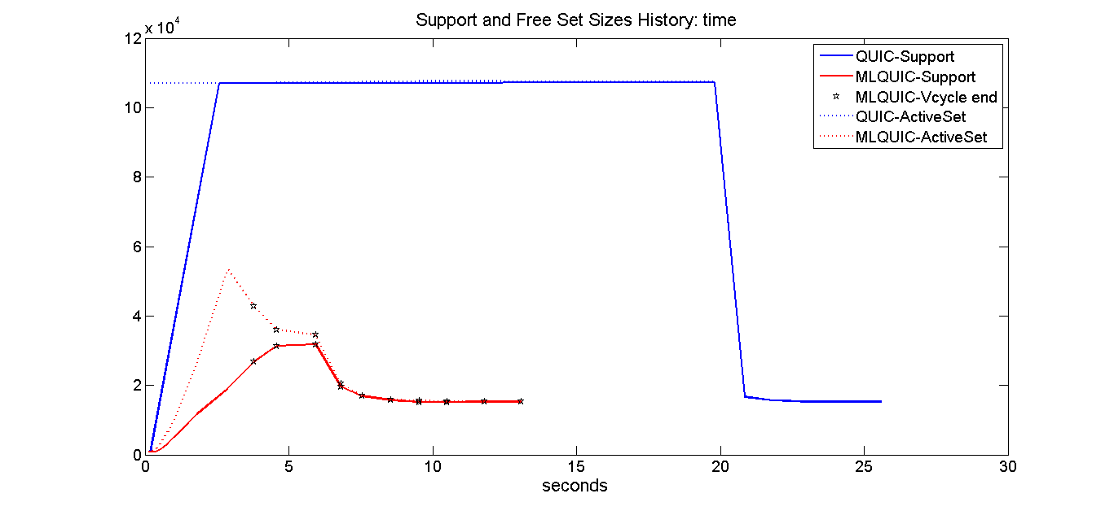

Numerical Results: Arabidopsis
Convergence history: $\left|ActiveSet\right|, |support|$

Slide 38
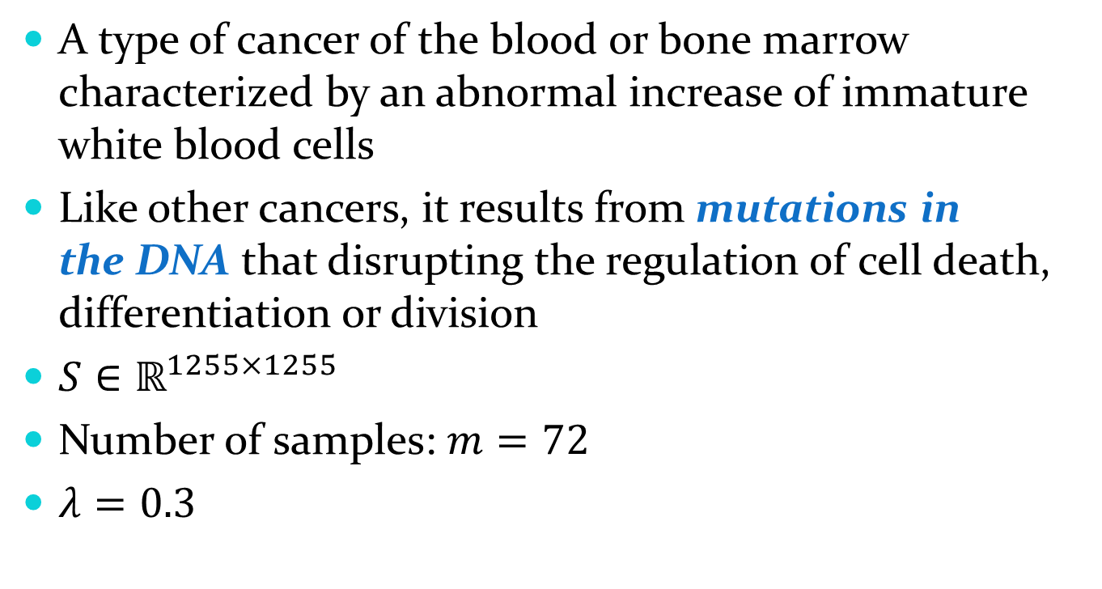
Numerical Results: Leukemia
A type of cancer of the blood or bone marrow characterized by an abnormal increase of immature white blood cells
Like other cancers, it results from mutations in the DNA that disrupting the regulation of cell death, differentiation or division
$S∈ℝ^{1255×1255}$
Number of samples: $m=72$
$λ=0.3$

Slide 39
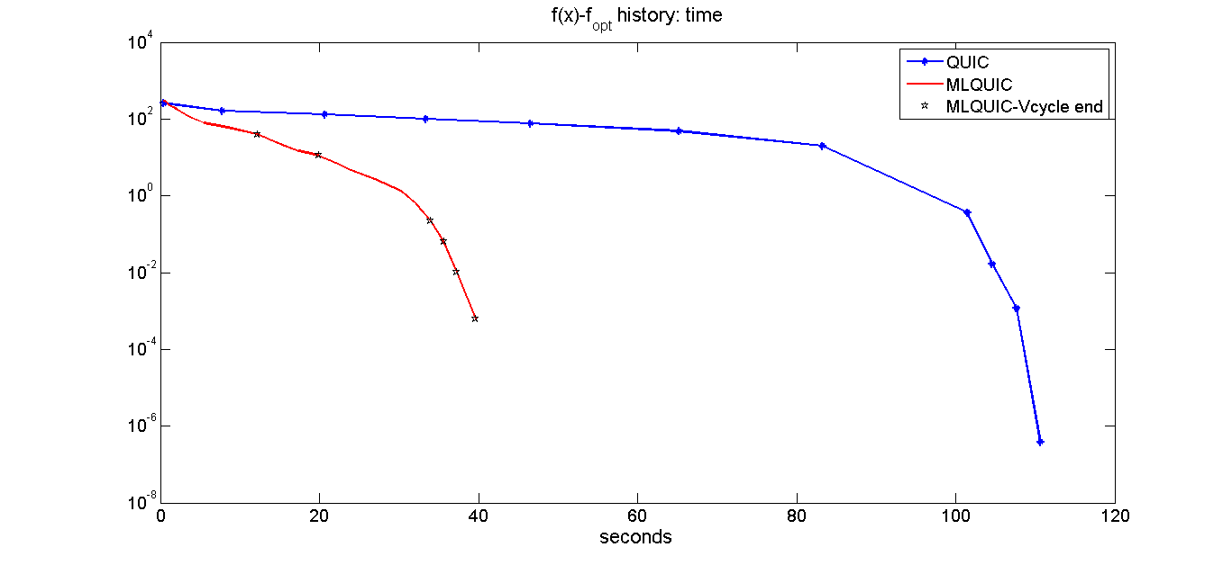
Numerical Results: Leukemia
Convergence history: $\left|F\left(A\right)−F_{min}\right|$

Slide 40
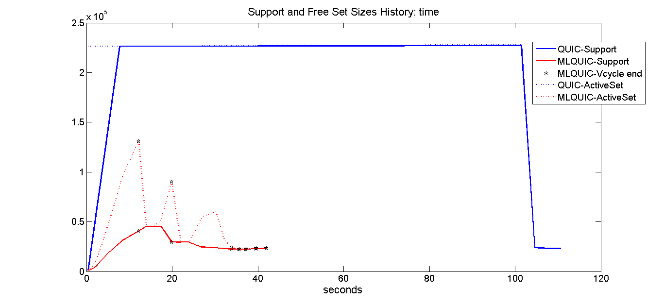
Numerical Results: Leukemia
Convergence history: $\left|ActiveSet\right|, |support|$

Slide 41
Conclusions
The multilevel approach is very promising.
Exploits the sparsity of the solution.
Accelerates existing iterated shrinkage methods.
Gradually builds the ActiveSet/support – resulting much smaller ActiveSet throughout the iterations.
Applicable also for other types of sparse minimization problems.

Slide 42
Questions? Thank you!

